Slide 1

NEXUS BANK
CASE STUDY
CUSTOMER SEGMENTATION AND DEPOSIT DETECTION

Slide 2

Introduction:
INTRODUCTION
Nexus Bank is a financial institution dedicated to delivering unparalleled banking services to our clients.
Our mission is to establish enduring relationships with our customers by providing tailored financial solutions that align with their individual needs and goals.
At Nexus Bank, we believe that every individual deserves access to world-class financial products and services, regardless of their age, profession, or income level. That's why we offer a wide spectrum of banking solutions to accommodate your lifestyle, including term deposits, personal loans, and mortgage financing. Our team of seasoned banking professionals is committed to providing you with the utmost level of service, transparency, and honesty.

Slide 3
The Task
Objectives
Nexus bank has conducted campaigns with the goal of acquiring deposits. The directors were unsatisfied with their current situation and need to optimize the operations at Nexus bank.
Leverage on data to gain insights into the bank and improve efficiency and identify patterns , trends in customer behaviour to decipher if customer demographics such as age, educational level etc. influences customer’s attitude toward defaulting.
Predict future customer behaviour and know the likelihood of deposits from customers. Understand how effective the bank campaigns are and thus develop marketing campaigns to reach specific customer segments.
Analyse customer behaviours, loan trends, and marketing campaign effectiveness, Nexus wants to optimize its operations, mitigate risks/ loan defaults, and improve customer deposits.
What is expected?

Slide 4



DATA PRE - PROCESSING
FUTURE ENGINEERING
DATA ENCODING
DATA SCALING
Drop unwanted features
Handle missing values
Handle categorical features
Remove outliers
Use label encoder to transform categorical data to numerical variables
Use the Min - Max scaler to scale the dataset – compress to balance and duration in the dataset

Slide 5
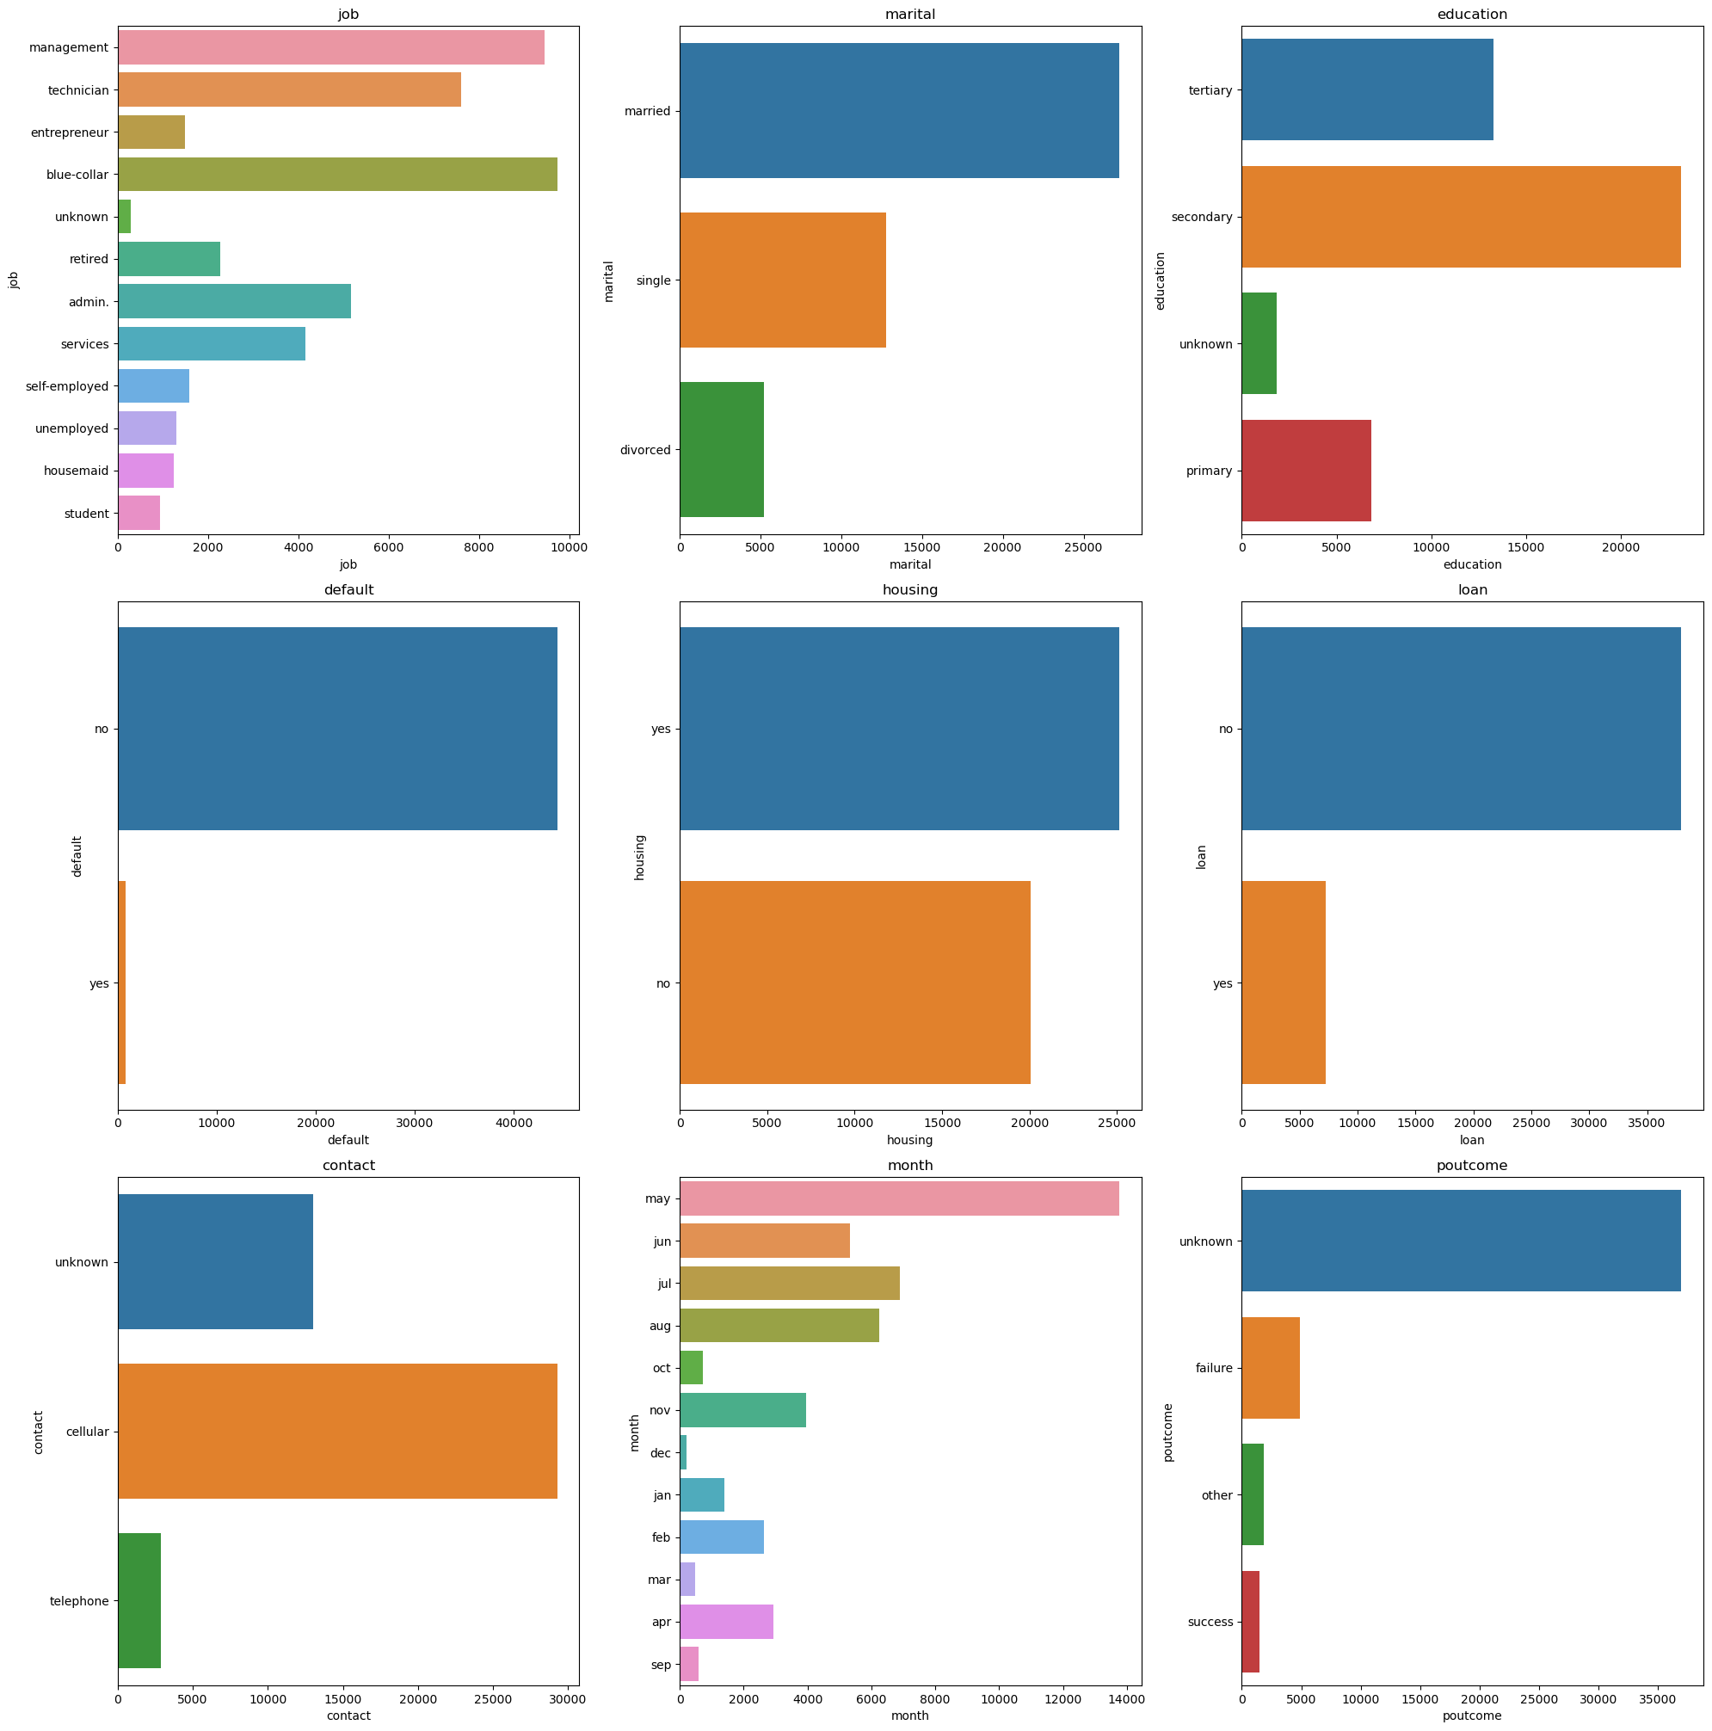
EXPLORATORY DATA ANALYSIS:
Univariate Analysis
Observation:
Customers with job type as management and blue-collar records are high in the given dataset and house are less
Married customers are high and divorced are less
The dataset shows customers with secondary educational background are higher
Default from the dataset does not play any significant role as it shows number of 'no'' in high ratio compared to the number of 'yes'
Monthly distribution in the data shows that May contributed high number while Dec shows lesser contribution

Slide 6
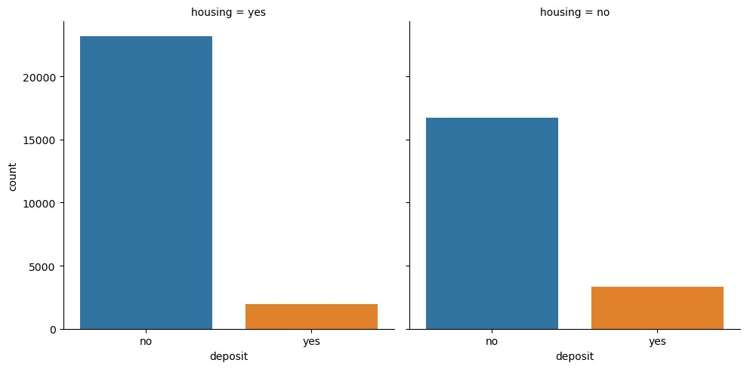
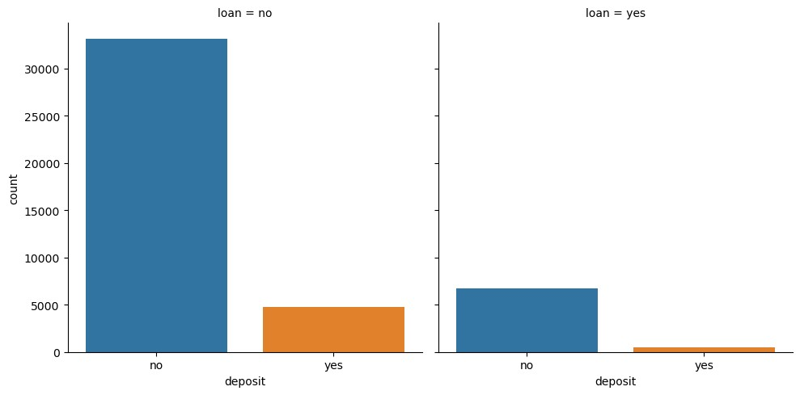
EXPLORATORY DATA ANALYSIS
Univariate Analysis
Observation:
From the dataset retired customers are interest in bank deposit
The month of May records high number with low ratio of interest in deposit
Customers with a housing loan to be uninterested in making a bank deposit
Campaign outcome with poutcome = success have high tendency of making deposit
March , September, October, and December customers showed much interest on deposit

Slide 7
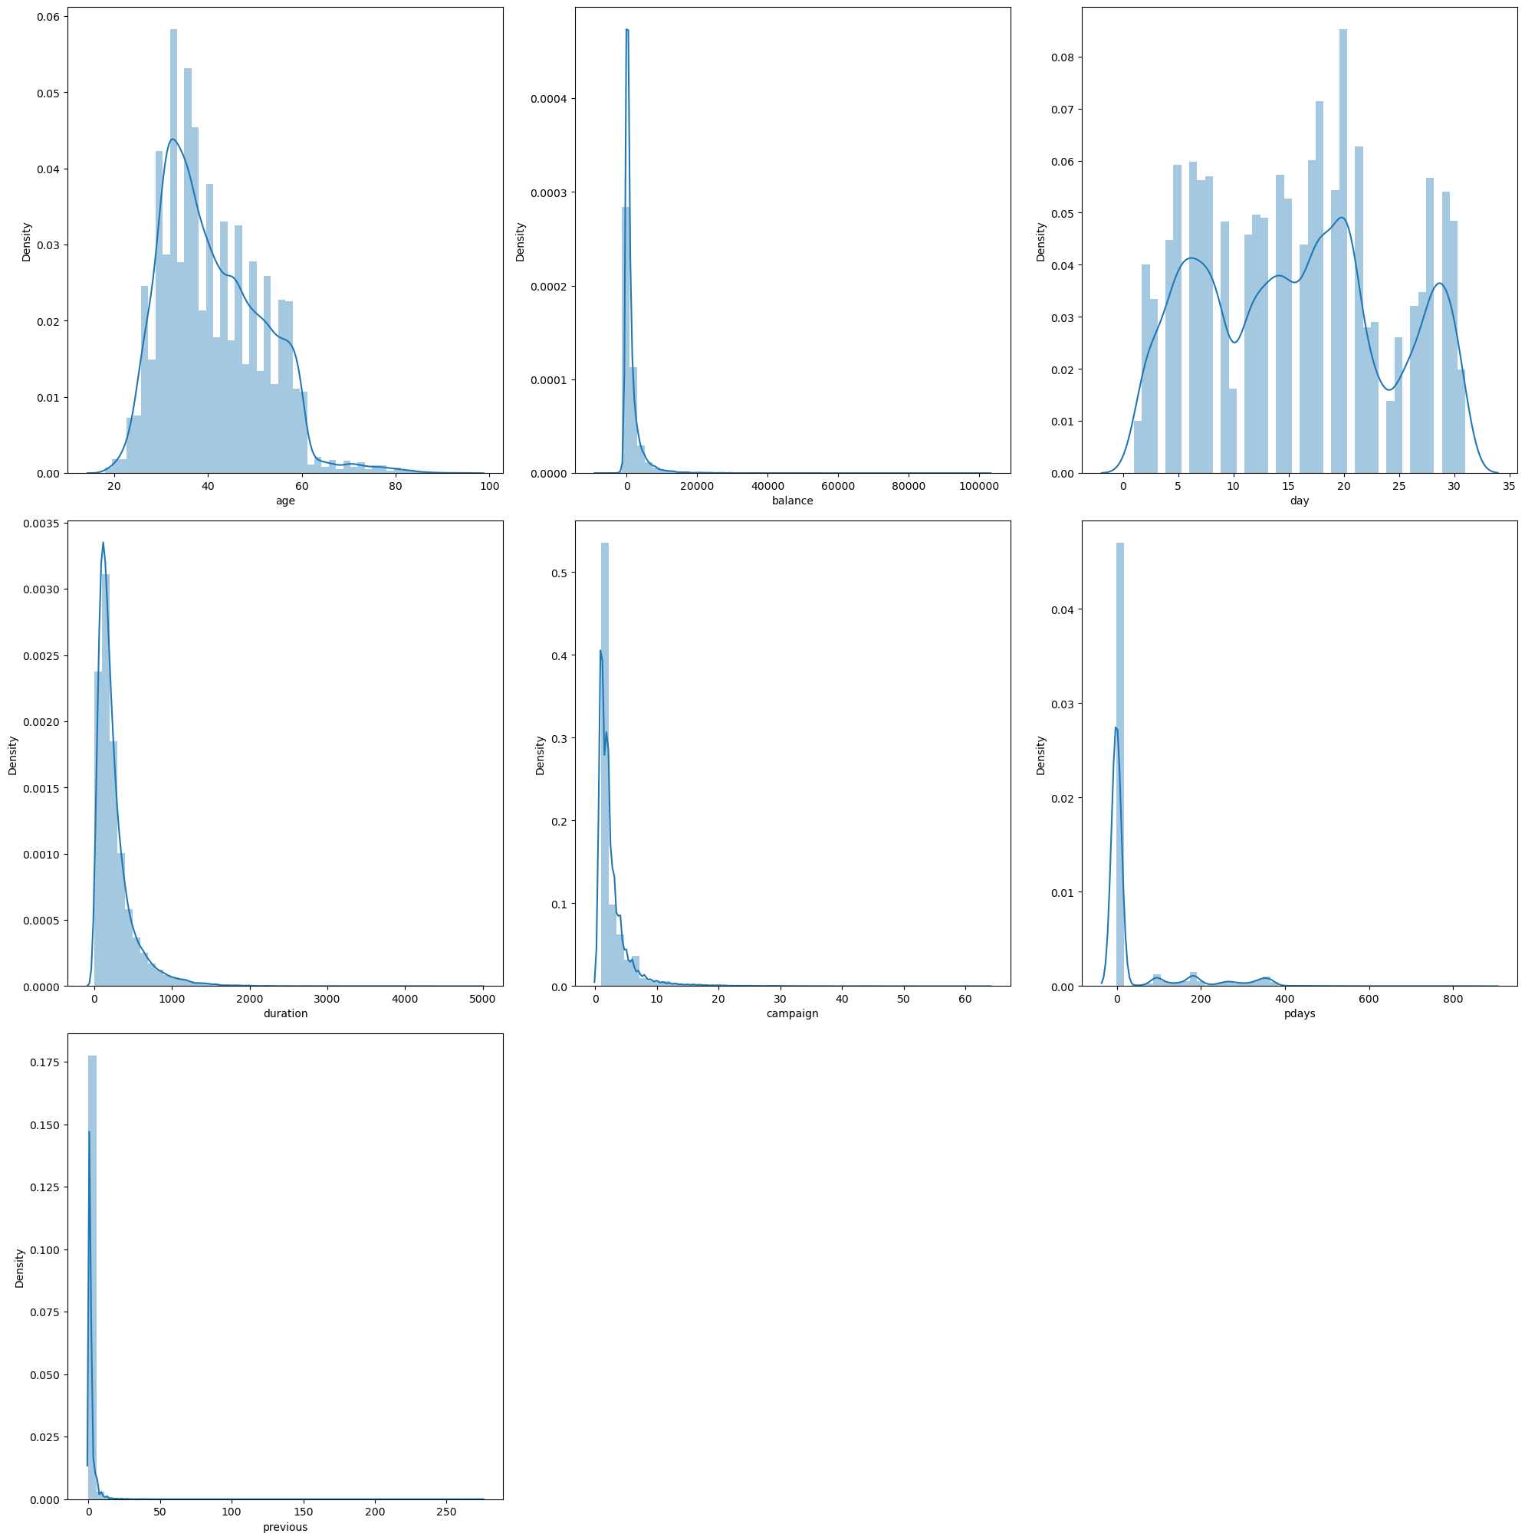
EXPLORATORY DATA ANALYSIS
Univariate distribution of continuous features
Observation:
The dataset indicate that balance, campaign, pdays, and previous are highly skewed towards the left hand and show number of outliers
Age and days are normally distributed

Slide 8
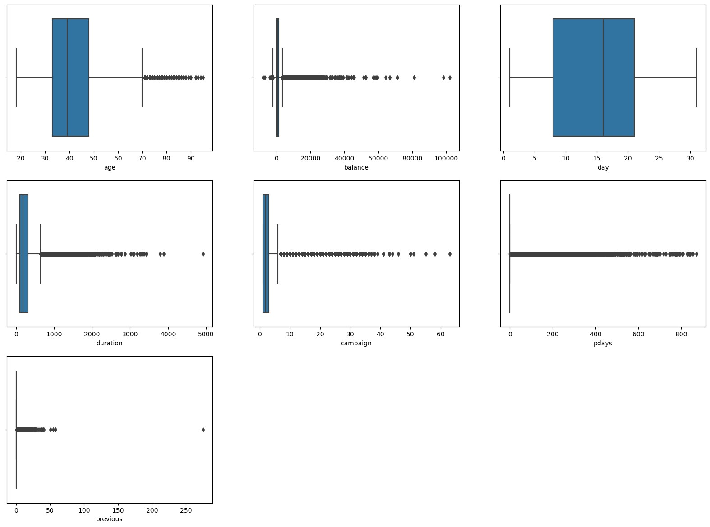
EXPLORATORY DATA ANALYSIS
Observation:
Previous, campaign, age, duration, pdays, and balance shows an outlier in the dataset

Slide 9
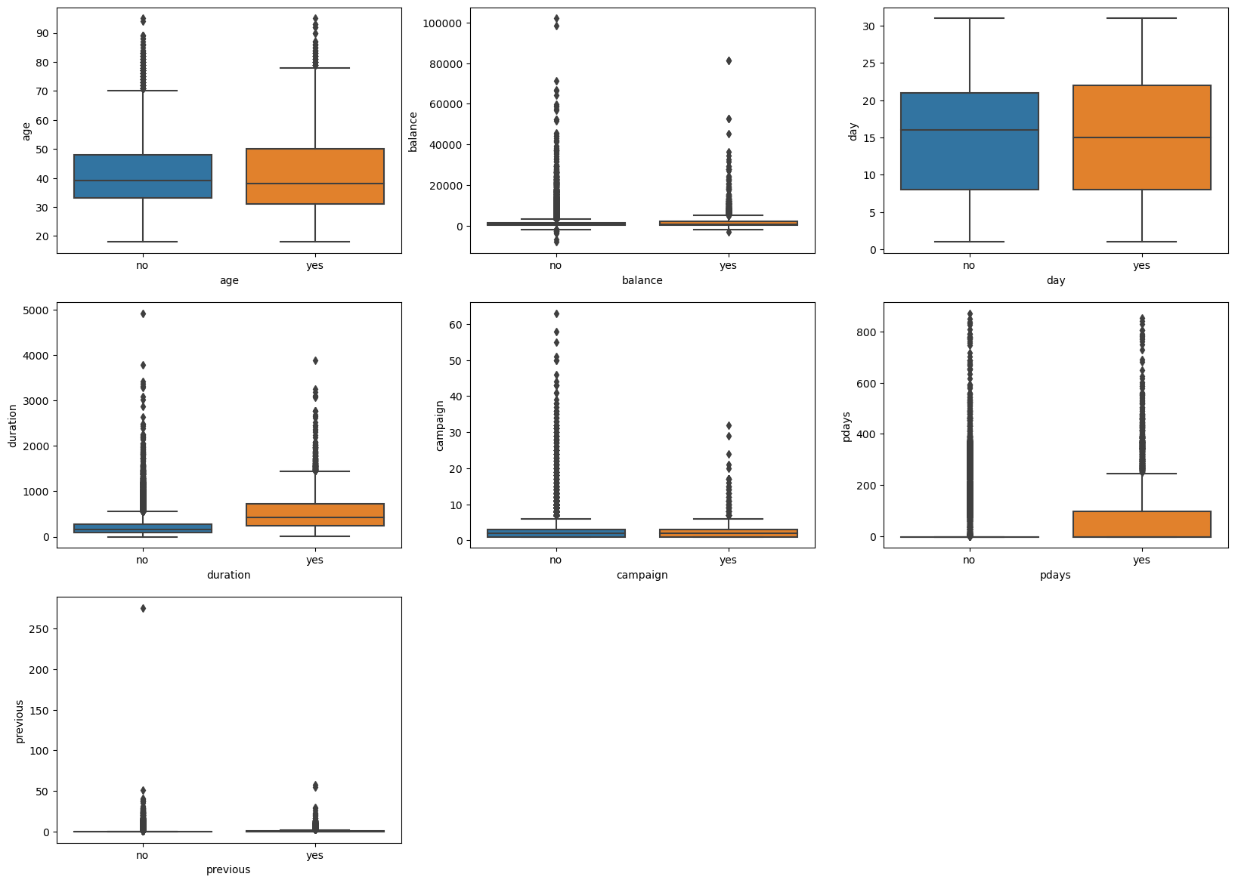
EXPLORATORY DATA ANALYSIS
Multivariate Analysis:
Relationship between continuous numerical features and label
Observation:
Long days engagement and communication shows that customers indicate interest on deposit.

Slide 10
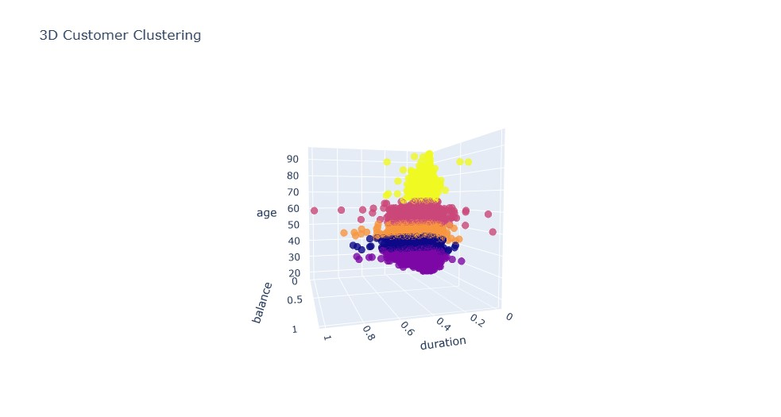
3 variable visualization for Age, balance and duration to show clusters.

Slide 11
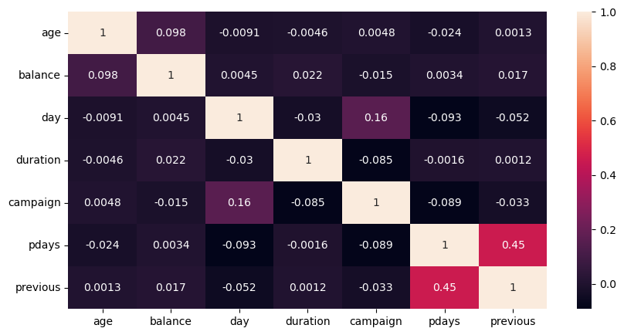
CORRELATION ANALYSIS
Observation:
There is no significant correlation observed among the variables in the dataset.

Slide 12
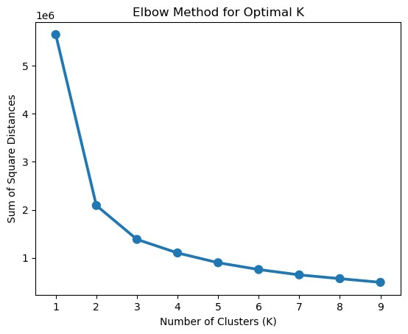
MODEL BUILDING -eLBOW METHOD
Determine the optimal number of clusters for customer segmentation.
The inertia starts decreasing from k=4

Slide 13
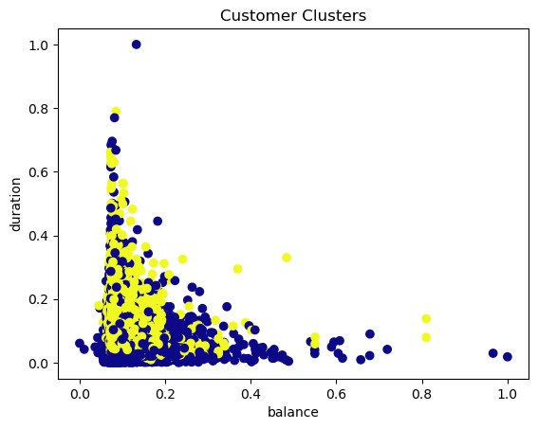
K-Means Clustering
Fit the data model
Determine the centroids
Visualize the clusters

Slide 14
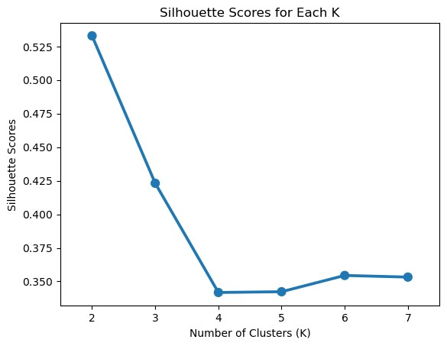

SILHOUETTE EVALUATION
Silhouette scores: 0.34110636768885627
The silhouette score analysis, shows that the best and optimal cluster for the customer segmentation is k=4

Slide 15
CONCLUSION:
CONCLUSION
Key Insights for Customer Segmentation and Deposit Marketing Strategy
Retired Customers
Retired customers have shown a strong interest in bank deposits.
b. Month of May: Low Conversion Ratio
May records a high number of interactions but a low ratio of interest in deposits.
Investigate reasons behind this trend and consider campaign adjustments for May.
c. Impact of Housing Loans
Customers with housing loans are generally uninterested in making bank deposits.
Develop targeted strategies to address concerns and promote deposit offerings to this customer segment.
d. Successful Campaign Outcomes
Campaign outcomes marked as "success" have a higher tendency to result in deposits.
Prioritize and replicate successful campaign strategies to increase overall deposit conversion rates.
e. Seasonal Patterns of Interest
Customers exhibit greater interest in deposits during March, September, October, and December.
Leverage these months for targeted marketing campaigns and promotional offers.

Slide 16
Cont.….
f. Understanding Customer Data
The dataset includes 7 continuous numerical features.
Certain features, such as balance, campaign, pdays, and previous, are skewed and contain outliers.
g. Normal Distribution and Outliers
Age and days follow a normal distribution, while other features have outliers.
Consider outliers in age, duration, pdays, campaign, previous, and balance for further analysis or data preprocessing.
h. Dataset Balance
The dataset exhibits balance between positive and negative responses for deposits.
Ensure equal representation of both deposit and non-deposit customers in future analysis and campaigns.
i. Optimal Customer Segmentation
Silhouette score analysis show the optimal number of clusters for customer segmentation is k=4 with silhouette score of 0.3444014756318102.
Utilize these segments to tailor marketing messages and strategies to specific customer groups.

Slide 17
Cont.….
j. No Correlation Between Variables
There is no significant correlation observed among the variables in the dataset.
Rely on other factors and insights to drive deposit marketing strategies rather than relying on inter-variable relationships.
These key insights provide actionable information to improve deposit conversion rates and develop targeted marketing strategies. By understanding customer behaviour, seasonality, and campaign outcomes, the bank can enhance its marketing efforts and drive customer engagement and deposit growth.

Slide 18


Kingsley Jolly Jackson
Data Science Consultant 10Alytics

